Slide 1
Direct Computation of Standardized Coefficients
or Standardizing a Model without Standardizing the Data
Doug Hemken

Slide 2
Motivating Scenario
A researcher is asked to include standardized coefficients in a revise-and-resubmit.
However, she has changed institutions and no longer has direct access to the data.
She does have her model estimates, and descriptive statistics.
The point of her model is the interaction term it includes.

Slide 3
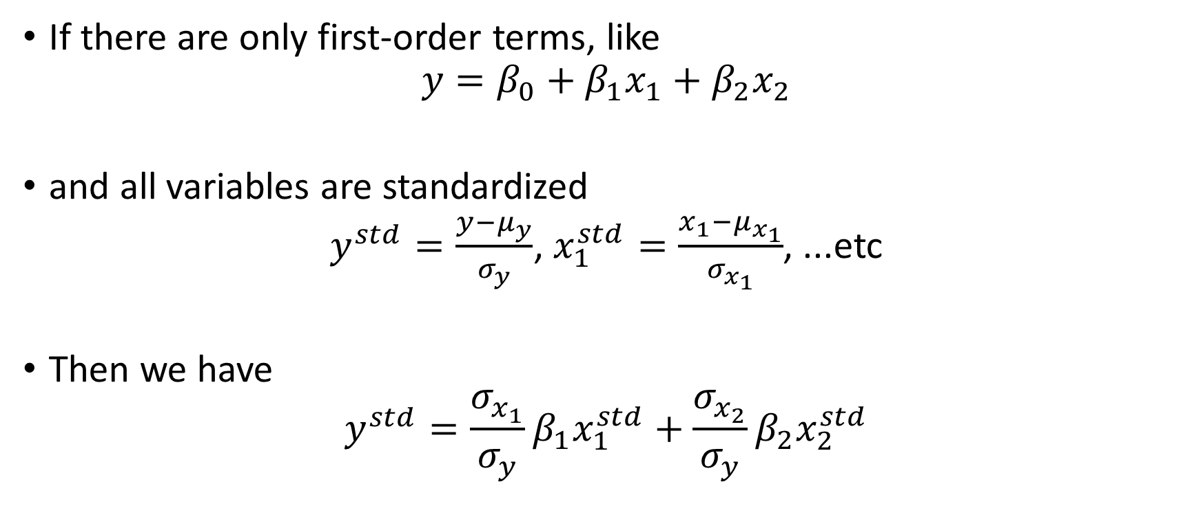
Additive Model == Simple Solution
If there are only first-order terms, like
$$y=β_{0}+β_{1}x_{1}+β_{2}x_{2}$$
and all variables are standardized
$y^{std}=\frac{y−μ_{y}}{σ_{y}}$, $x_{1}^{std}=\frac{x_{1}−μ_{x_{1}}}{σ_{x_{1}}}$, ...etc
Then we have
$$y^{std}=\frac{σ_{x_{1}}}{σ_{y}}β_{1}x_{1}^{std}+{\frac{σ_{x_{2}}}{σ_{y}}β}_{2}x_{2}^{std}$$

Slide 4

In other words …
The classic formula taught in a first course in regression $β_{i}^{std}={\frac{σ_{x_{i}}}{σ_{y}}β}_{i}$

Slide 5
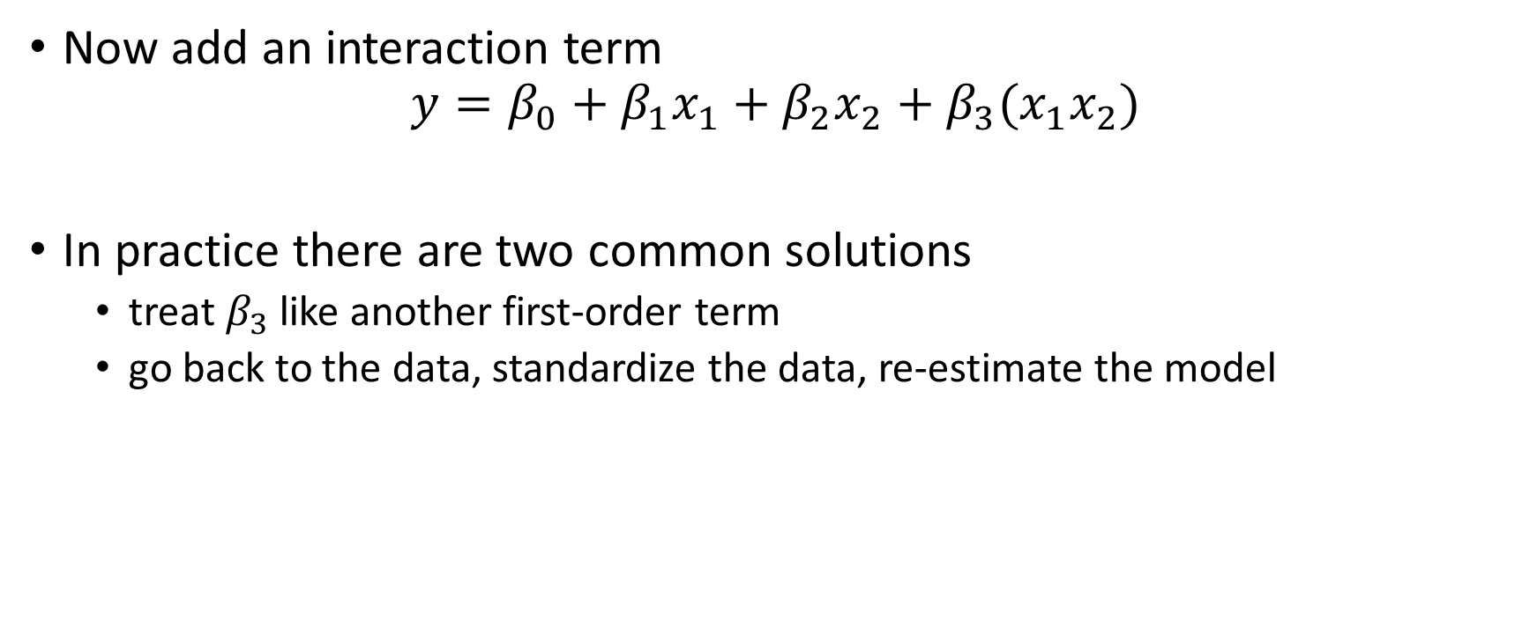
Interaction Model == Choices
Now add an interaction term
$$y=β_{0}+β_{1}x_{1}+β_{2}x_{2}+β_{3}(x_{1}x_{2})$$
In practice there are two common solutions
treat $β_{3}$ like another first-order term
go back to the data, standardize the data, re-estimate the model

Slide 6

Use a "First-Order" Solution
Most software does this
$${\left(x_{1}x_{2}\right)}^{std}=\frac{(x_{1}x_{2})−μ_{(x_{1}x_{2})}}{σ_{(x_{1}x_{2})}}$$
Then
$$β_{3}^{std}=\frac{σ_{({x_{1}x}_{2})}}{σ_{y}}β_{3}$$

Slide 7
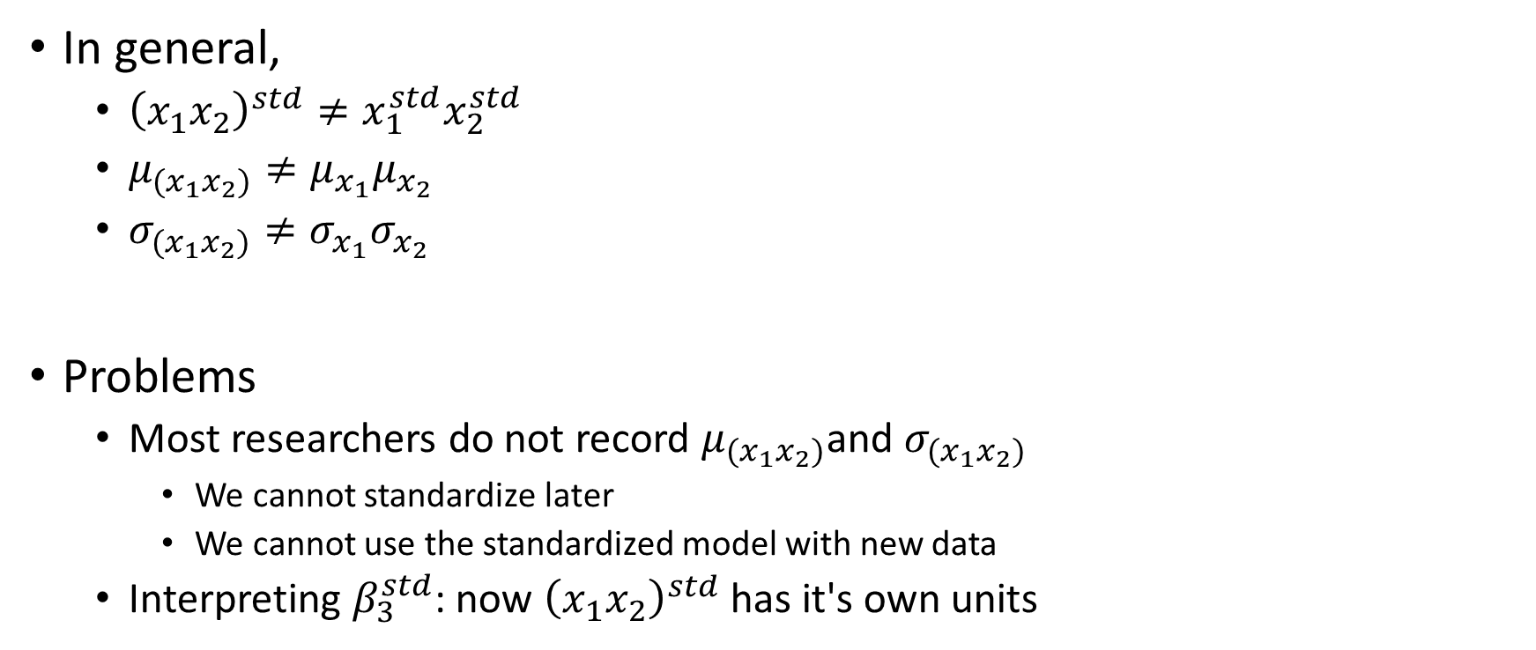
"First-Order" Problems
In general,
${\left(x_{1}x_{2}\right)}^{std}≠x_{1}^{std}x_{2}^{std}$
$μ_{(x_{1}x_{2})}≠μ_{x_{1}}μ_{x_{2}}$
$σ_{(x_{1}x_{2})}≠σ_{x_{1}}σ_{x_{2}}$
Problems
Most researchers do not record $μ_{(x_{1}x_{2})}$and $σ_{(x_{1}x_{2})}$
We cannot standardize later
We cannot use the standardized model with new data
Interpreting $β_{3}^{std}$: now ${\left(x_{1}x_{2}\right)}^{std}$ has it's own units

Slide 8
"Go Back to the Data" Problems
You can't always go back to the data
Restricted data
Latent (unobserved) variables, i.e. no data to begin with
Streaming data
Old journal articles
It requires unnecessary computation

Slide 9

Direct Standardization
Break this into several linear transformations
Recentering and rescaling $y$
Recentering the $x_{i}$
Rescaling the $x_{i}$

Slide 10

One variable, recentered
Suppose we have a model
$$y=β_{0}+β_{1}x_{1}$$
Or in matrix form
$$y=Xb$$
If we recenter
$$x^{c}=x_{1}−μ$$
Our new coefficients are
$$b^{c}=\left[\begin{matrix}1 & μ \\ 0 & 1\end{matrix}\right]b$$

Slide 11
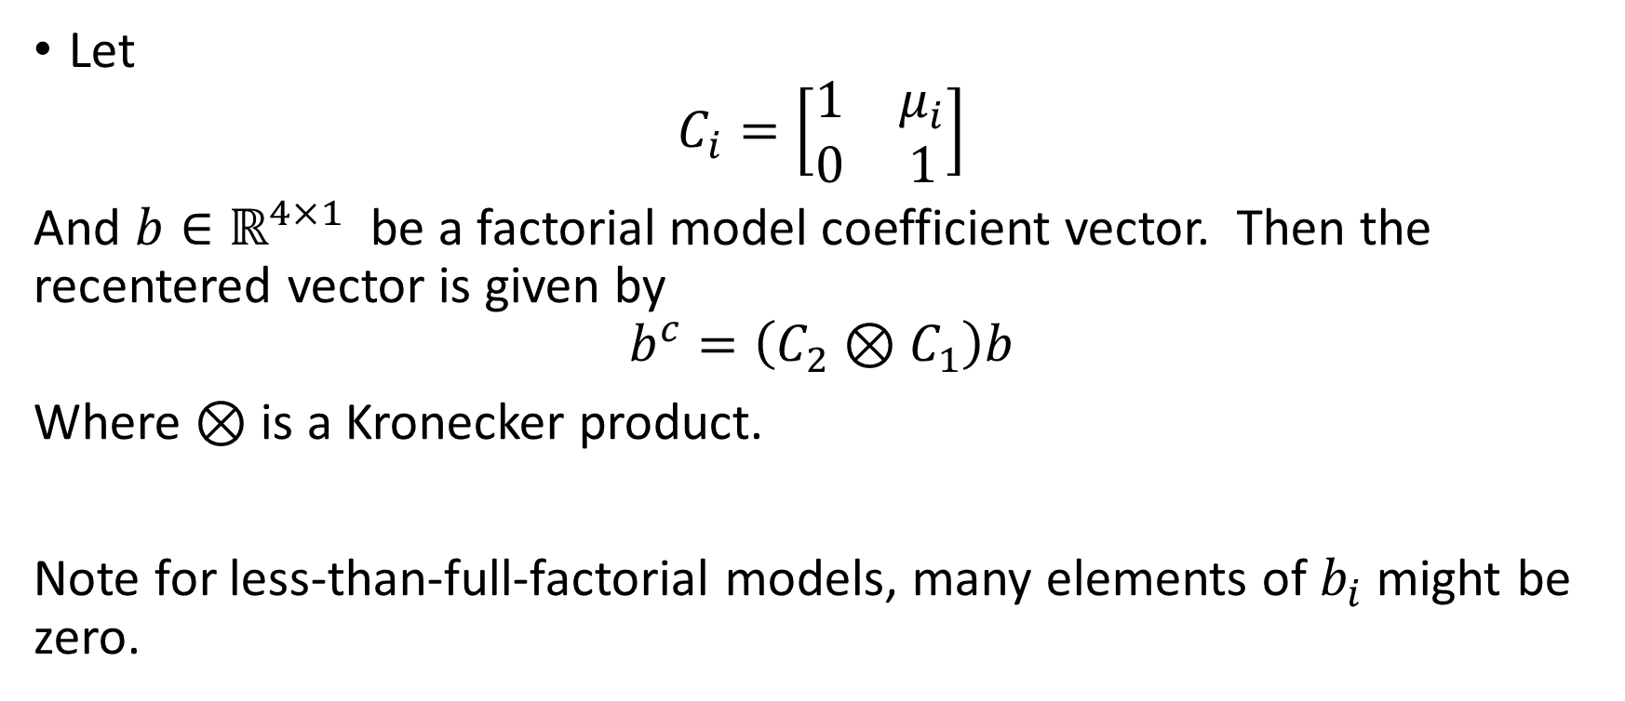
Two variables, recentered
Let
$$C_{i}=\left[\begin{matrix}1 & μ_{i} \\ 0 & 1\end{matrix}\right]$$
And $b∈ℝ^{4×1}$ be a factorial model coefficient vector. Then the recentered vector is given by $$b^{c}=\left(C_{2}⊗C_{1}\right)b$$
Where $⊗$ is a Kronecker product.
Note for less-than-full-factorial models, many elements of $b_{i}$ might be zero.

Slide 12

Example, recentering
$$\left[\begin{matrix}b_{0}^{c} \\ b_{1}^{c} \\ b_{2}^{c} \\ b_{3}^{c}\end{matrix}\right]=\left[\begin{matrix}1 & μ_{1} & μ_{2} & μ_{1}μ_{2} \\ 0 & 1 & 0 & μ_{2} \\ 0 & 0 & 1 & μ_{1} \\ 0 & 0 & 0 & 1\end{matrix}\right]\left[\begin{matrix}b_{0} \\ b_{1} \\ b_{2} \\ b_{3}\end{matrix}\right]$$

Slide 13

Rescaling is similar, and easier
We have a rescaling matrix for a single $x$ variable
$$S_{i}=\left[\begin{matrix}1 & 0 \\ 0 & σ_{i}\end{matrix}\right]$$
And rescaling a two-variable model is
$$b^{std}=\left(S_{2}⊗S_{1}\right)b^{c}$$

Slide 14

Example, rescaling
$$\left[\begin{matrix}b_{0}^{std} \\ b_{1}^{std} \\ b_{2}^{std} \\ b_{3}^{std}\end{matrix}\right]=\left[\begin{matrix}1 & 0 & 0 & 0 \\ 0 & σ_{1} & 0 & 0 \\ 0 & 0 & σ_{2} & 0 \\ 0 & 0 & 0 & σ_{1}σ_{2}\end{matrix}\right]\left[\begin{matrix}b_{0}^{c} \\ b_{1}^{c} \\ b_{2}^{c} \\ b_{3}^{c}\end{matrix}\right]$$

Slide 15

Standardization matrices
It is important to recenter everything first, then rescale
$$b^{std}=\left(S_{2}⊗S_{1}\right)\left(C_{2}⊗C_{1}\right)b$$
Denote this
$$Z=\left(S_{2}⊗S_{1}\right)\left(C_{2}⊗C_{1}\right)$$

Slide 16
Change of Basis
Our parameter space (for generalized linear models) is derived as a tensor product of the basis vectors for the data space.
Linear changes in the basis of the data space induce a change of basis in the parameter space, as expressed by the Kronecker product.
This also gives us a start on dealing with polynomial terms, in addition to interaction terms.
We can apply our change of basis to other vectors and matrices in the parameters space, notably the parameter variance-covariance matrix.

Slide 17
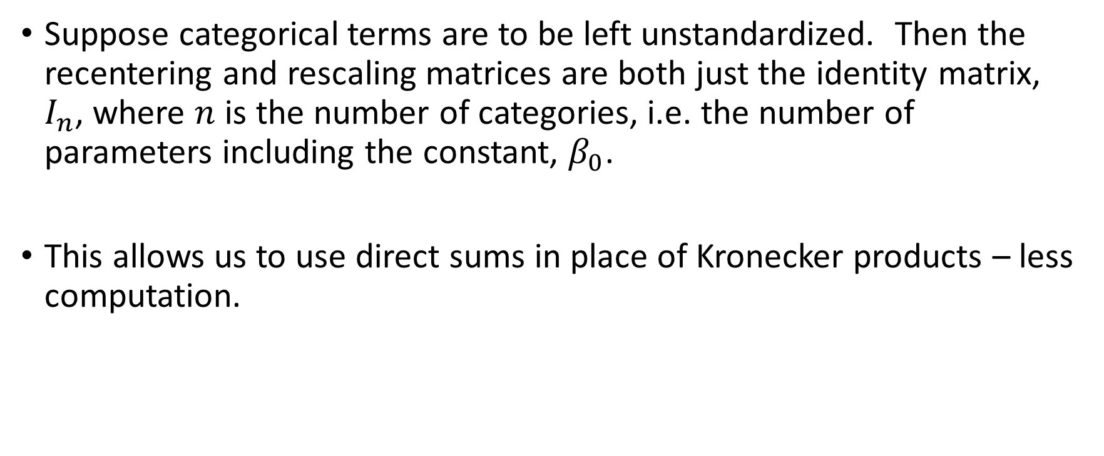
Categorical terms
Suppose categorical terms are to be left unstandardized. Then the recentering and rescaling matrices are both just the identity matrix, $I_{n}$, where $n$ is the number of categories, i.e. the number of parameters including the constant, $β_{0}$.
This allows us to use direct sums in place of Kronecker products – less computation.

Slide 18
Implementation
The basic computation is simple – most matrix languages include Kronecker products
Keeping track of parameter/column order is required
Sorting variables to standardize versus not standardize
Polynomial terms require collecting like terms
Factorial designs grow rather quickly, so adding one variable at a time and trimming unneeded higher-order terms will help.

